Slide 1




RAGHU ENGINEERING COLLEGE
Accredited by NAAC A+ and NBA, Affiliated to JNTU-GV(Vizianagaram) Dakamarri (V), Bheemunipatnam (M), Visakhapatnam
DEPARTMENT OF COMPUTER SCIENCE & ENGINEERING
A LEARNING MODEL ON CUSTOMER CHURN FORECASTING FOR TELECOM PROVIDERS
Under the esteemed guidance of,
Mr. A. A. Narasimham, Assistant Professor.
Presented by – BATCH 42 (CSE - C)
SV Manikanta 21981A05D9 Syed Asmath 21981A05F9 T Ramakrishna 21981A05G5 T Shalini 21981A05H1

Slide 2
OVERVIEW
Abstract
Use Case Diagram
Literature Survey
Sequence Diagram
Existing Systems
Activity Diagram
Proposed System
Reference

Slide 3
ABSTRACT
In the competitive telecom industry, keeping customers is vital for profit and growth. This project aims to understand why customers leave their telecom providers. By looking at past data on customer behavior, service usage, and interactions, we want to find patterns that show when a customer might leave. We will collect and study different information, like account details, service history, and feedback. This will help us identify key signs of potential departure and the reasons behind it. With these insights, telecom companies can create strategies to improve customer satisfaction, enhance service quality, and take proactive steps to keep their customers. The main goal is to provide useful information that helps telecom providers reduce customer turnover, improve retention efforts, and build long-term relationships with their customers.

Slide 4
Literature Survey-1
Applying Survival Analysis to Telecom Churn Data
Algorithms
Cox Proportional Hazard Model:
A statistical method that examines the effect of multiple variables on the time to an event (e.g., customer churn). It calculates hazard ratios for predictors.
Key Findings
Cox Proportional Hazard Model was applied to predict customer churn using various predictors like campaign effectiveness, tariff plans, tenure, and age.
Tenure and auto-payment positively impact customer retention.
Customers with shorter tenure and no auto-payment have higher churn probabilities.

Slide 5
Applying Survival Analysis to Telecom Churn Data
Model: Cox Proportional Hazard Model
A statistical method used to examine the effect of multiple variables on the time until an event (customer churn) occurs.
Focuses on survival and hazard functions to identify high-risk customers.
Merits
Accurate prediction of churn probabilities over time using survival analysis.
Identifies key factors influencing customer churn (e.g., tenure, auto-payment).
Demerits
Considered the survival chances of consumers.

Slide 6
Literature Survey-2
Customer Churn Prediction in Telecom Sector Using Machine Learning Techniques
Algorithms
Decision Tree: A tree-like structure where nodes represent features, and branches represent decision outcomes, making it interpretable and easy to implement.
Random Forest: An ensemble learning method using multiple decision trees and averaging their results to improve accuracy and reduce overfitting.
Key Findings
Accuracy: Achieved a prediction accuracy of 99% using the Random Forest classifier.
Precision and Recall: The classifier matrix showed 99% precision and recall, with an overall accuracy of 99.09%.
Provided an efficient business model for churn prediction to enable proactive actions by identifying churners early.

Slide 7
Customer Churn Prediction in Telecom Sector Using Machine Learning Techniques
Model: Random Forest Classifier
An ensemble learning model that builds multiple decision trees and combines their outputs for improved accuracy and reduced overfitting.
Merits
High accuracy (99.09% using Random Forest).
Easy implementation and scalability.
Demerits
May overfit on small datasets.
Requires balanced datasets for optimal results.

Slide 8
Literature Survey-3
Customer Churn Prediction in Telecom Using Machine Learning in Big Data Platform
Algorithms
XGBoost: An advanced gradient boosting algorithm that uses decision trees. It is efficient, handles missing values, and offers high predictive performance.
Gradient Boosted Machines (GBM): A machine learning technique that builds models sequentially, where each model corrects errors from the previous one.
Key Findings
Achieved an AUC of 93.3% using the XGBoost algorithm with Social Network Analysis (SNA) features.
Improved model performance significantly (from 84% to 93.3% AUC).
XGBoost outperformed Gradient Boost Machines, Random Forest, and Decision Trees in terms of prediction accuracy and scalability.

Slide 9
Customer Churn Prediction in Telecom Using Machine Learning in Big Data Platform
Model: XGBoost (Extreme Gradient Boosting)
A gradient boosting framework optimized for speed and performance, which builds decision trees sequentially to minimize prediction errors.
Merits
High AUC score (93.3% using XGBoost).
Scalable to large datasets (70TB).
Demerits
High computational cost for SNA.
Complexity in feature engineering.

Slide 10
Literature -4
Customer Churn Prediction System: A Machine Learning Approach
Algorithms
Gravitational Search Algorithm (GSA): An optimization technique inspired by Newtonian gravity that selects relevant features by simulating interactions between objects in a search space.
Support Vector Machine (SVM):
A supervised learning algorithm that finds the hyperplane that best separates classes.
Key Findings
AdaBoost and XGBoost classifiers achieved the highest accuracy of 81.71% and 80.8%.
The Gravitational Search Algorithm (GSA) effectively reduced data dimensionality, improving overall performance.
Demonstrated the value of ensemble learning and optimization techniques in improving prediction accuracy.

Slide 11
Customer Churn Prediction System: A Machine Learning Approach
Model: AdaBoost and XGBoost Classifiers
AdaBoost: Boosting model that combines weak classifiers iteratively.
XGBoost: Advanced gradient boosting algorithm focusing on efficiency.
Merits
Reduces data dimensionality and prevents overfitting.
AUC of 84% using AdaBoost and XGBoost.
Demerits
Limited improvement in class imbalance.
High dependency on feature selection accuracy.

Slide 12
Literature Survey-5
The perils of proactive churn prevention- Using plan recommendations
Algorithms
Randomized Control Trial (RCT): Used to evaluate the impact of encouraging customers to switch to cost-minimizing plans.
Behavioral Analysis: Applied to understand the unintended effects of interventions, such as lowering customer inertia and increasing the salience of past usage patterns.
Key Findings
Encouraging customers to switch to cost-minimizing plans unexpectedly increased churn rates.
Churn in the treatment group was 10%, compared to 6% in the control group.
Salience of Past Usage Patterns: The encouragement highlighted overspending or dissatisfaction, triggering latent churn behavior.

Slide 13
The perils of proactive churn prevention- Using plan recommendations
Model: Randomized Control Trial (RCT) and Behavioral Analysis
Behavioral Model: Explores the psychological and behavioral effects of interventions on customer decision-making.
Merits
Highlights potential unintended consequences of proactive churn prevention strategies.
Demerits
No machine learning or automated prediction models were used.

Slide 14
Literature Survey-6
Customer churn prediction using machine learning- A study in the B2B subscription
Algorithms
XGBoost: Decision-tree-based ensemble boosting technique for strong classifier performance.
Random Forest: An ensemble learning method using multiple decision trees and averaging their results to improve accuracy and reduce overfitting.
Key Findings
XGBoost and Random Forest outperformed Naïve Bayes in predicting churn, with higher accuracy, precision, and recall.
Metrics such as accuracy, precision, recall, and F1-score were used to assess the models. Ensemble methods performed consistently better than single models like Naïve Bayes.

Slide 15
Customer churn prediction using machine learning- A study in the B2B subscription
Model: Machine Learning-based Churn Prediction
A binary classification model to predict whether a customer will churn in a subscription-based B2B context.
Merits
Sampling methods improved classifier performance on imbalanced data.
Comprehensive evaluation using metrics like accuracy, precision and recall.
Demerits
Limited focus on economic implications of churn prediction.
Study specific to financial administration in the B2B context.

Slide 16
EXISTING SYSTEMS
Survival Analysis Models: Predict churn timing using the Cox Proportional Hazard Model, focusing on factors like tenure and payment methods.
Machine Learning Models: Random Forest, KNN, and Decision Trees are widely used for churn classification, with Random Forest achieving high accuracy.
Big Data Platforms: Utilize Hadoop and Spark to handle massive datasets and integrate Social Network Analysis (SNA) for enhanced features.
Boosting Algorithms: Models like XGBoost and AdaBoost improve prediction accuracy by combining weak learners.
Feature Optimization: Techniques like Gravitational Search Algorithm (GSA) reduce dimensionality and enhance model performance.
Challenges in Existing Systems:
Scalability issues with traditional data processing methods.
Overfitting risks in standalone models.
Limited real-time adaptability for large-scale dynamic datasets.

Slide 17
PROPOSED SYSTEMS
Algorithms:
Logistic Regression: A statistical algorithm used for binary classification tasks by modeling the probability of a certain class using a sigmoid function.
Support Vector Classifier: A supervised learning algorithm that identifies the hyperplane maximizing the margin between data classes.
Naive Bayes: A probabilistic algorithm based on Bayes' theorem, assuming strong independence between features.
Decision Tree: A tree-like model where nodes represent feature splits and leaves represent class labels, making it interpretable.
Random Forest: An ensemble algorithm that combines multiple decision trees using bagging to reduce overfitting and improve accuracy.

Slide 18
PROPOSED SYSTEMS
Data-Driven Model:
Gather relevant data such as customer demographics, usage patterns, and churn history.
Enhanced Machine Learning Approach:
Perform model evaluation using metrics such as Accuracy, Precision, Recall, and F2 Score.
Advanced Optimization Techniques:
Handle class imbalance using resampling techniques like SMOTE.
Merits:
Improved Feature Selection and Handling Class Imbalance
Dynamic and Adaptive Model Updates

Slide 19
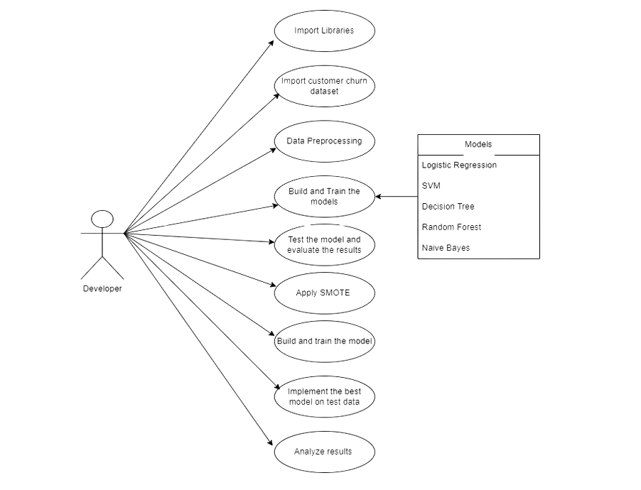
USE CASE DIAGRAM

Slide 20
USE CASE DIAGRAM
Actors
Developer: The sole actor responsible for interacting with the system at different stages of model development and deployment.
Use Cases:
Import Libraries
Import Customer Churn Dataset
Data Preprocessing
Build and Train the Models
Test the Model and Evaluate the Results
Apply SMOTE
Implement the Best Model on Test Data
Analyse Results

Slide 21
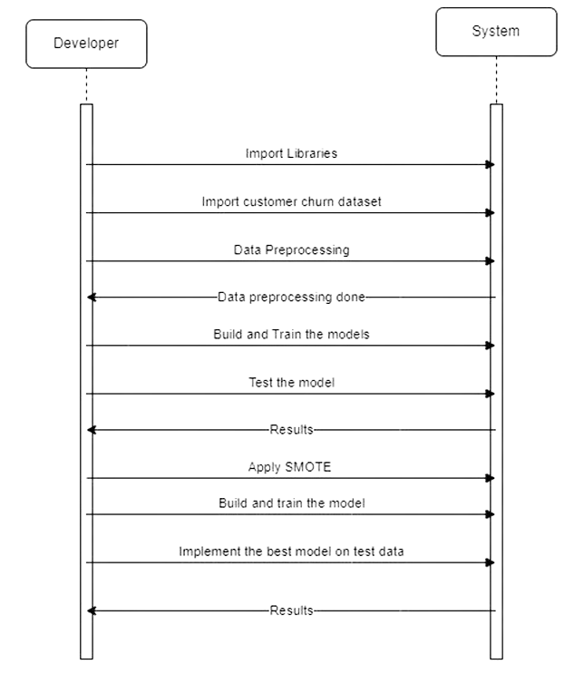
SEQUENCE DIAGRAM

Slide 22
SEQUENCE DIAGRAM
Sequence of Steps:
Import Libraries: Developer initiates the import of required libraries for data manipulation and machine learning.
Import Customer Churn Dataset: The developer uploads the dataset, and the system processes the request.
Data Preprocessing: The developer commands data preprocessing. The system completes preprocessing and returns confirmation ("Data preprocessing done").
Build and Train the Models: The system builds and trains the models as instructed by the developer.
Test the Model: The system evaluates the trained models, providing test results back to the developer.
Apply SMOTE: The developer instructs the system to address class imbalance using SMOTE.
Build and Train the Model Again: The model is retrained with balanced data after SMOTE application.
Implement the Best Model on Test Data: The developer selects the best-performing model, and the system applies it to test data.
Analyse Results: The system provides the results from the best model implementation to the developer.

Slide 23
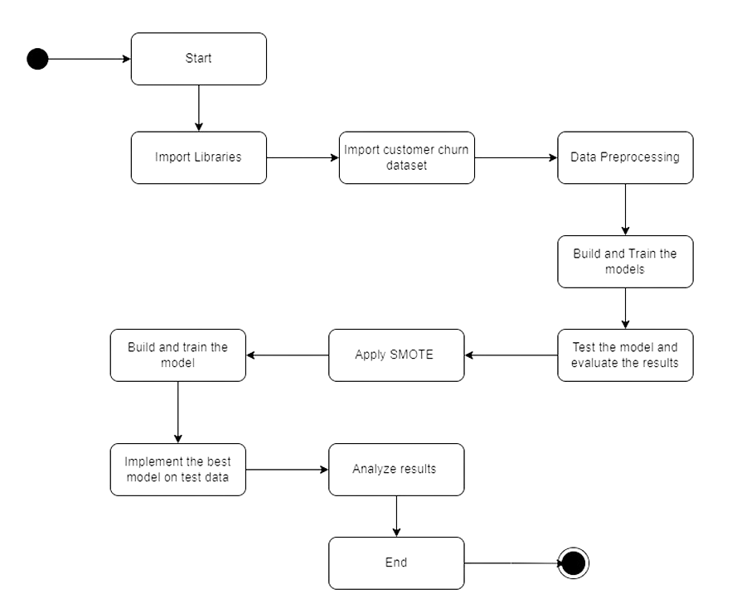
ACTIVITY DIAGRAM

Slide 24
ACTIVITY DIAGRAM
Flow of Activities:
Import Libraries: Developer initiates the import of required libraries for data manipulation and machine learning.
Import Customer Churn Dataset: The developer uploads the dataset, and the system processes the request.
Data Preprocessing: The developer commands data preprocessing. The system completes preprocessing and returns confirmation ("Data preprocessing done").
Build and Train the Models: The system builds and trains the models as instructed by the developer.
Test the Model: The system evaluates the trained models, providing test results back to the developer.
Apply SMOTE: The developer instructs the system to address class imbalance using SMOTE.
Build and Train the Model Again: The model is retrained with balanced data after SMOTE application.
Implement the Best Model on Test Data: The developer selects the best-performing model, and the system applies it to test data.
Analyse Results: The system provides the results from the best model implementation to the developer.

Slide 25
REFERENCE
Melik Masarifoglu, Ali Hakan Buyuklu, Applying Survival Analysis to Telecom Churn Data, American Journal of Theoretical and Applied Statistics. Volume 8, Issue 6, November 2019.
Sharmila K. Wagh, Aishwarya A. Andhale , Kishor S. Wagh , Jayshree R. Pansare, Sarita P. Ambadekar , S.H. Gawande, Customer churn prediction in telecom sector using machine learning techniques
Ahmad, A.K., Jafar, A. & Aljoumaa, K. Customer churn prediction in telecom using machine learning in big data platform. J Big Data 6, 28 (2019).
Lalwani, Praveen & Mishra, Manas & Chadha, Jasroop & Sethi, Pratyush. (2022). Customer churn prediction system: a machine learning approach Computing.
Ascarza E, Iyengar R, Schleicher M. The perils of proactive churn prevention using plan recommendations: evidence from a field experiment. J Market Res. 2016.
Benjamin Ghaffari & Yasin Osman, Customer churn prediction using machine learning A study in the B2B subscription-based service context (2021).

Slide 26
Thank You

